Slide 1
Lesson Overview
Begin with the Stop & Think on HO3 (new) -3min. Have a brief discussion (no more than 5 min, just get 2-3 ideas out on the table)
Set goals for the day 2min– remind them that they need to look at all the resources and complete the worksheet from yesterday. They also need to revise their models based on the new resources, make evidence from the new resources and link it. This is all the resources they will get so now they are working on their FINAL model.
Work on MEME 40min- spend rest of period working on MEME.
(no Before You Go today)
Total time- 50 mins.

Slide 2
LESSON 4 - DAY 3

Slide 3
STOP & THINK!
Grab handout 2 and put your name and information on the top of the first page.
Complete the STOP & THINK! question on the first page.
Do you think it’s possible to have several models about the same thing that are all right, but have different components and mechanisms?
Notes:
Use this “Stop & Think” as a do now. 3min
Have a very brief class discussion, just get 2-3 ideas out.
.

Slide 4
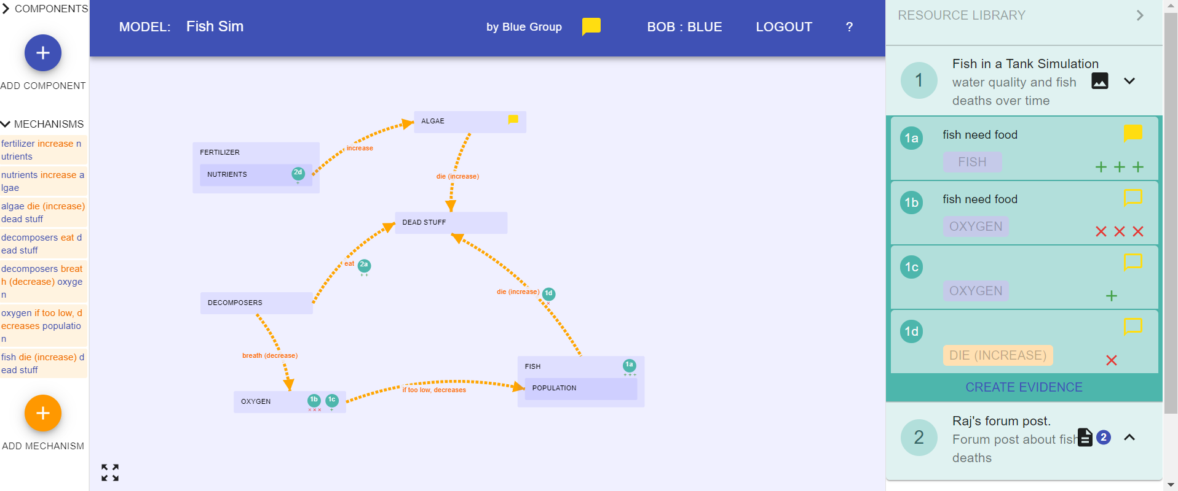
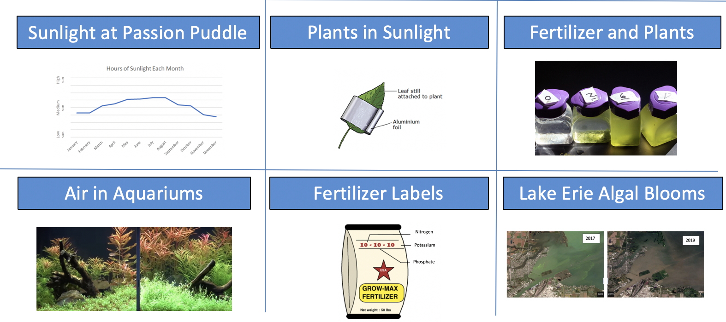





MEME: Revise Your Model
Our question today: What causes algae to bloom?
Read through all the new resources & answer questions.
What new evidence do they provide?
How should you change your model?
Make sure your model meets the new class criteria and there is evidence supporting EVERY part.
Dead Fish
Notes:
3 min instructions– remind them of the task– figuring out what the algae bloomed
They should be looking at each resource answering questions on their handout and revising their models
Pretty much the entire period is devoted to this task
They need to develop what willl be their final model– this is the last time they will have to work on these models
Please have class criteria visible
Class criteria are on next slide, go over them briefly – just remind them

Slide 5

Class Criteria
Dead Fish
Insert image of your class criteria here
Notes:
Just briefly read these to remind the class
And move on to next slide– leave those instructions up

Slide 6
MEME: Revise Your Model
Our question today: What causes algae to bloom?
Read through all the new resources & answer questions.
What new evidence do they provide?
How should you change your model?
Make sure your model meets the new class criteria and there is evidence supporting EVERY part.
Dead Fish
Notes:
Leave this slide up as they work

Slide 7
End of Class
Notes:
There is no Before You Go today

Slide 8
Evidence Set
Lesson 4
Why are there more algae?
Notes:
In case you need to project evidence, they are all here

Slide 9
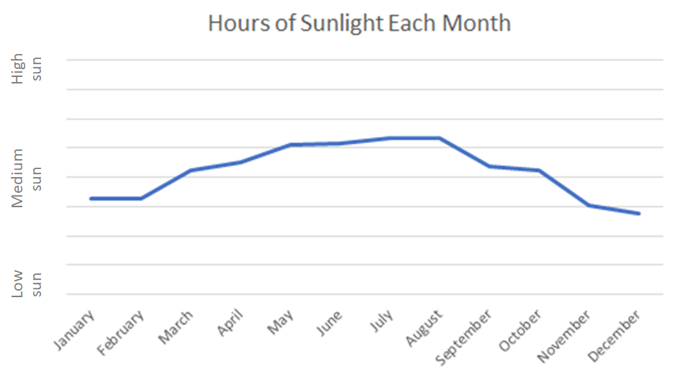
Amount of Sunlight at Passion Puddle
Around Passion Puddle there are instruments that can measure the amount of sunlight hitting the water. Here are the measurements of sunlight from each month during the year in which there was an algal bloom (too much algae):

Slide 10
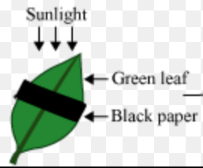
Plants in Sunlight
Plants are producers. This means they produce their own food (sugar) using sunlight energy. Scientists did an experiment to see what happens if only part of a leaf gets sunlight. They took a plant and selected five big green leaves. They then covered half of each leaf with a piece of aluminum foil, to hide that half from the sun, like the diagram below.
After a couple of days, they picked the leaves off the plant and tested each section of the leaf to see if it made sugar. They found sugar only in the parts of the leaves that were left out in the sun. There was no sugar in the parts that were covered.

Slide 11

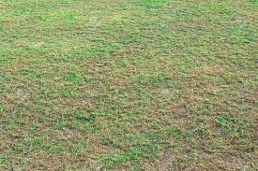
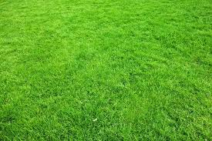
Fertilizer and Plants
Part A: Fertilizer for Water Lilies
The football field at Penn State is not used much during the spring. This is when the Penn State gardeners add fertilizer to the field. One of the gardeners took a photo to show what the grass looks like at the end of football season (January) and what it looks like in the spring after it has been fertilized in March.
Field in January Before Fertilizer Field in Spring After Fertilizer

Slide 12
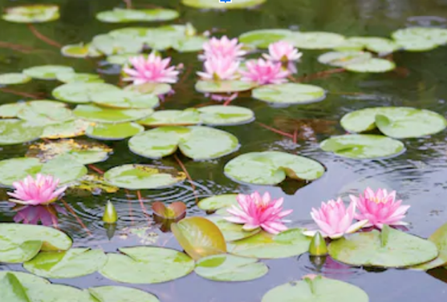
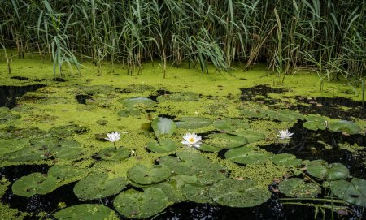
Penn State also has a wonderful lotus pond with water lilies. The gardeners wondered if the same amount of fertilizer would work for increasing the beautiful water lilies. They added the fertilizer and the water lilies grew a lot, but the algae in the pond grew, too. Instead of becoming more beautiful, the pond became green and mucky!
Before Fertilizer After Fertilizer

Slide 13
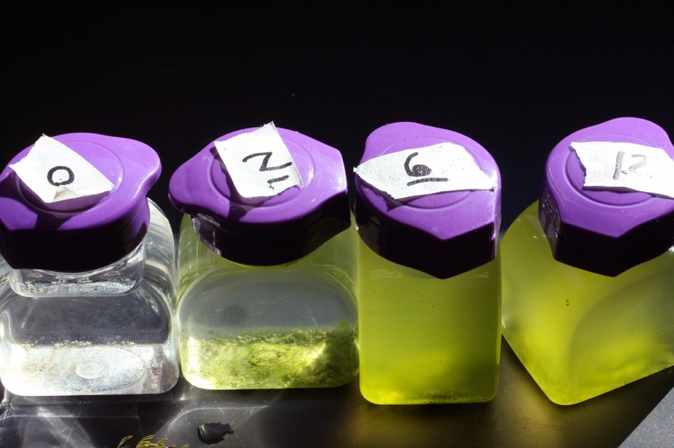
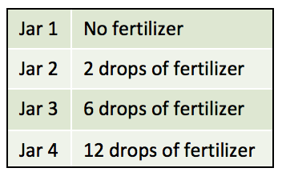
Part B: Fertilizer and Algae
The gardeners decided to test how much fertilizer made the algae grow so that they could put in just enough to help the water lilies, but not so much that the pond gets full of algae.
They took four jars of pond water. They did not add any fertilizer to the first jar. In the second jar they added 2 drops of fertilizer. In the third jar they added 6 drops of fertilizer. In the fourth jar they added 12 drops of fertilizer.
They observed the jars after one month to see what happened to the algae. Here are their results:

Slide 14
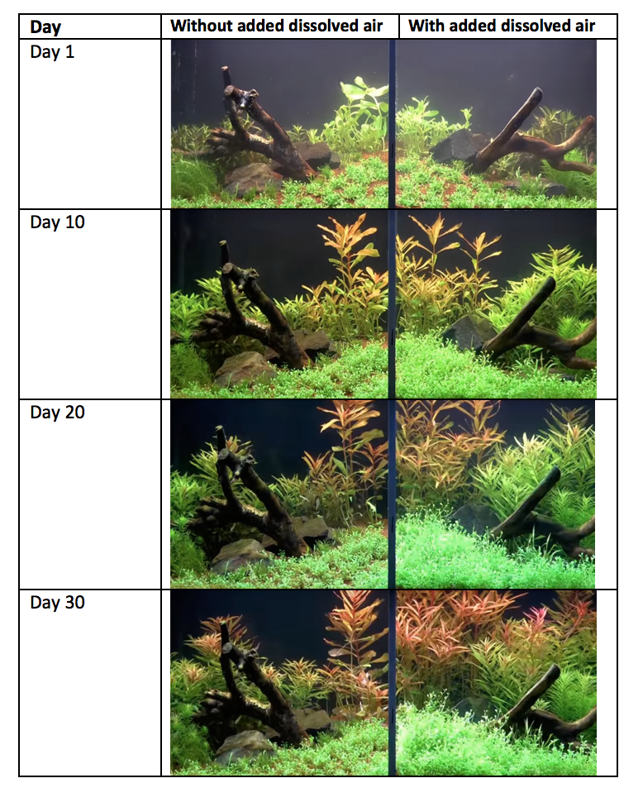
Air in Aquariums
In the Adventure Aquarium in New Jersey, aquarists (aquarium experts) wanted to try a new machine that adds dissolved air into the water, to see if they should buy it for more tanks.
To find out, they put two tanks side by side. They planted the same plants in each of them. Then, in one tank, they connected the machine so that it would add dissolved air into the water so that it had lots of dissolved air. In the other tank they did not do anything: whatever dissolved air was already in the water stayed, but they did not add any new air.
They took photos of the tank every 10 days for a month. They also posted the pictures on their website so that members of the public could see the experiment. The photos are shown here:

Slide 15
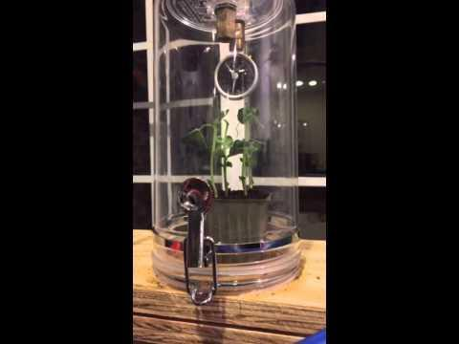
The aquarists also wanted to show visitors what happens when plants are put in a vacuum machine. They put a plant in a vacuum machine and turned it on. The machine sucks the air out of the jar. They filmed it for six hours and sped it up into this video that they posted on the website:
Notes:
(Video here: https://www.youtube.com/watch?v=H3oyYEp7eTo)

Slide 16
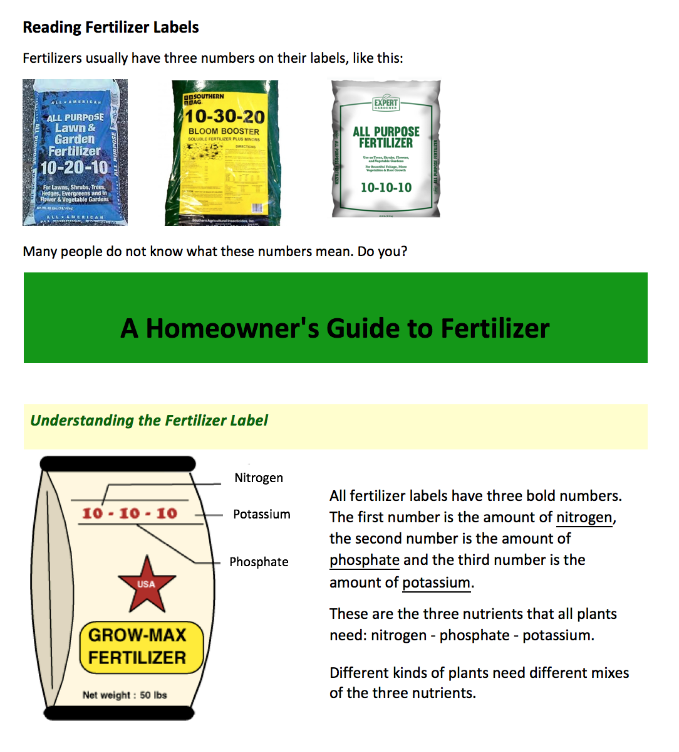

Slide 17
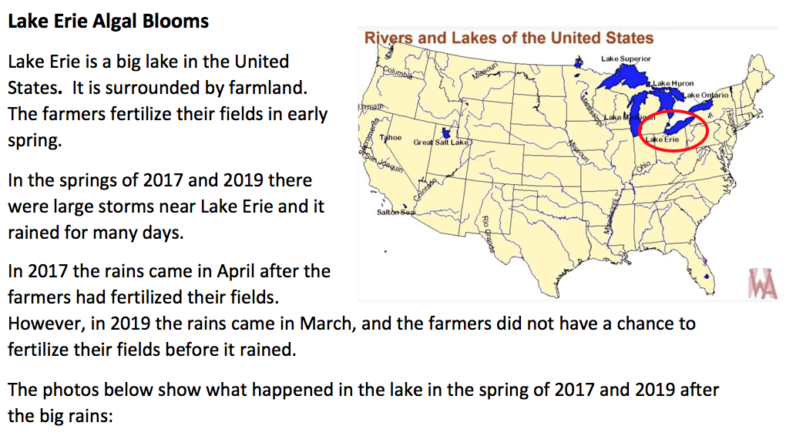

Slide 18
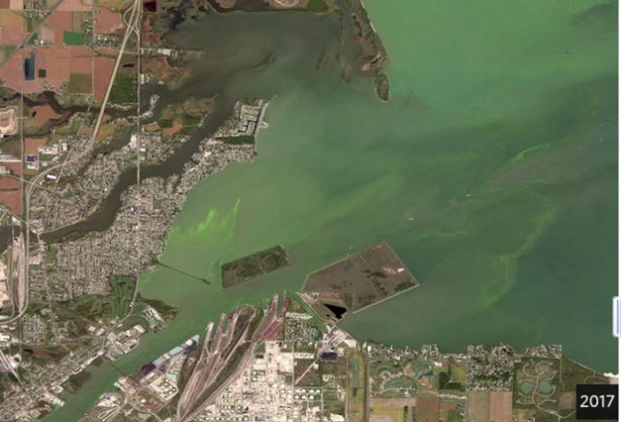
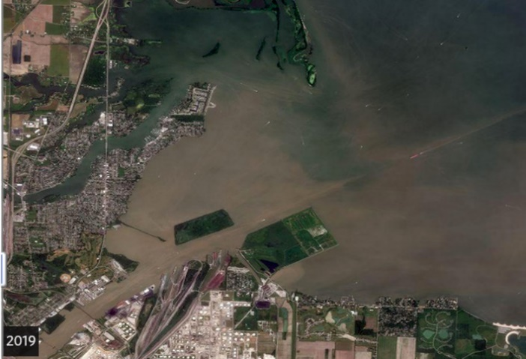
2017
2019
Rain washes dirt from fields into the lake and makes the lake brown. However, after a few weeks the dirt settles and the lake water becomes clear again.
In both 2017 and 2019 dirt washed into the lake, but there were algal blooms only in 2017.
Scientists studying Lake Erie took water samples from the lake right after it rained in 2017 and 2019. They found that there were a lot more nutrients in the water in 2017 than in 2019.

